Slide 1
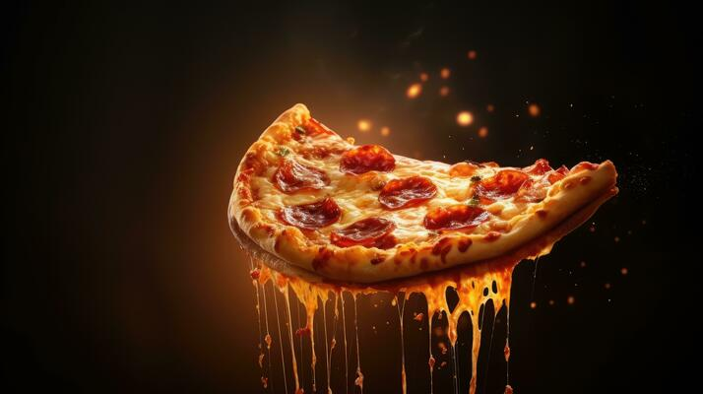
By Nishigandha Jadhav
Aspirant Data analyst

Slide 2
INTRODUCTION
Pizza is widely enjoyed Italian dish made from flattened dough topped with ingredients like cheese, tomatoes, meats and vegetables. Originating in Naples in the late 18th century, it features various styles, including Neapolitan, Chicago deep-dish. New York-style, and Sicilian. Pizza has gained global popularity, with local adaptions reflecting regional tastes. The industry has experienced significant growth, especially in delivery and takeout, influenced by consumer behavior.

Slide 3
OBJECTIVES
To determine the total revenue generated from pizza sales.
To find the highest-priced pizza.
To figure out which size of pizzas are mostly ordered.
To figure out which category pizzas are mostly ordered.
To determine the top 5 most ordered pizzas.
To determine how many average pizzas sales per day.
To identify the Top 3 pizzas according to their revenue.
To figure out the contribution of each pizza type to total revenue.

Slide 4

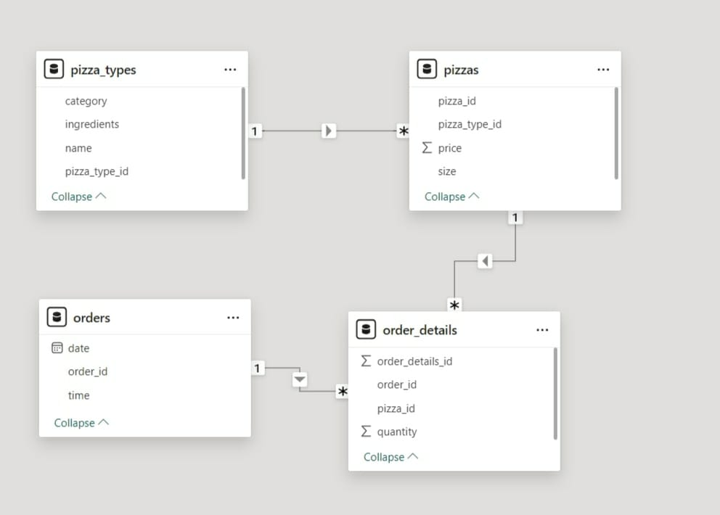
Data Table Structures and Their Interrelationships

Slide 5
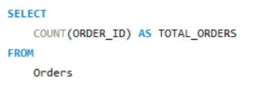

1) Retrieve the total number of orders placed.

Slide 6
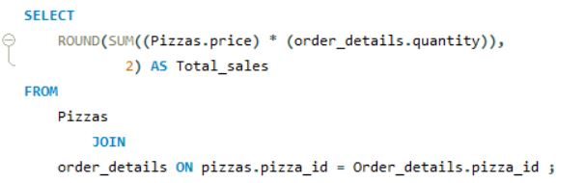

2) Calculate the total revenue generated from pizza sales.

Slide 7
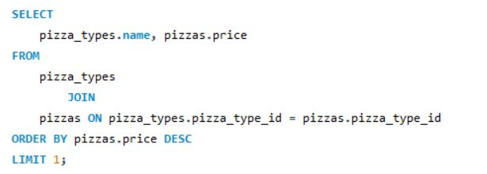

3) Identify the highest-priced pizza.

Slide 8
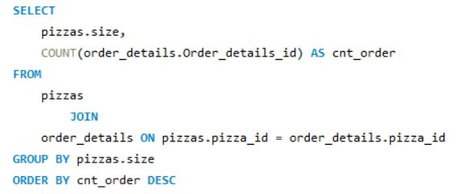
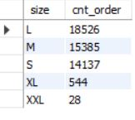
4) Identify the most common pizza size ordered.

Slide 9
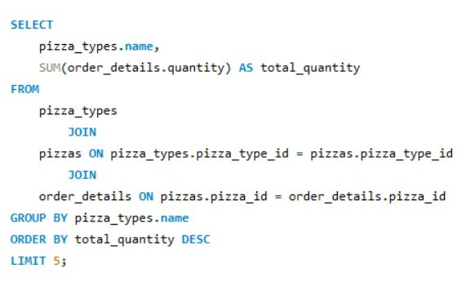
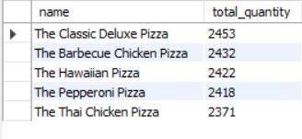
5) List the top 5 most ordered pizza types along with their quantities.

Slide 10
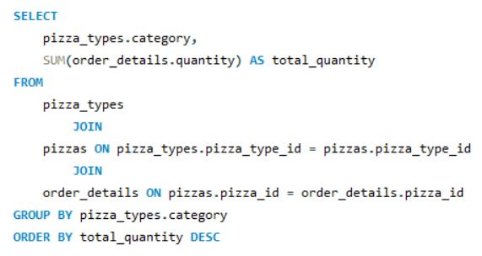
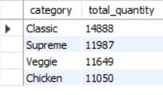
6) Join the necessary tables to find the total quantity of each
pizza category ordered.

Slide 11
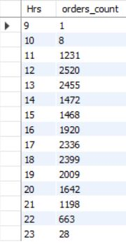
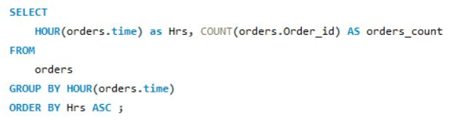
7) Determine the distribution of orders by hour of the day.

Slide 12
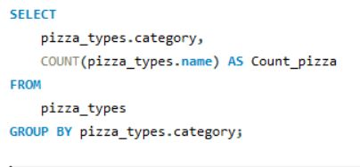
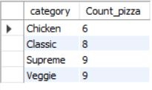
8) Join relevant tables to find the category-wise distribution of
pizza.

Slide 13
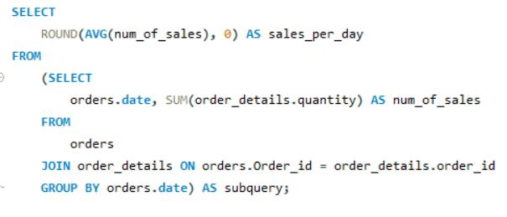

Group the orders by date and calculate the average number of
pizzas ordered per day.

Slide 14
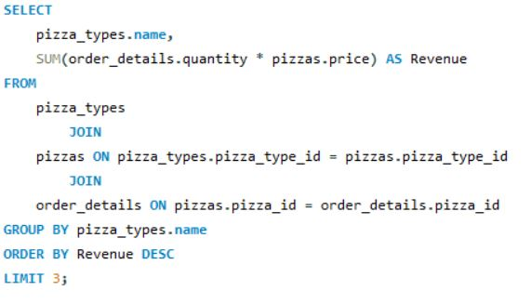

10) Determine the top 3 most ordered pizza types based on
revenue.

Slide 15
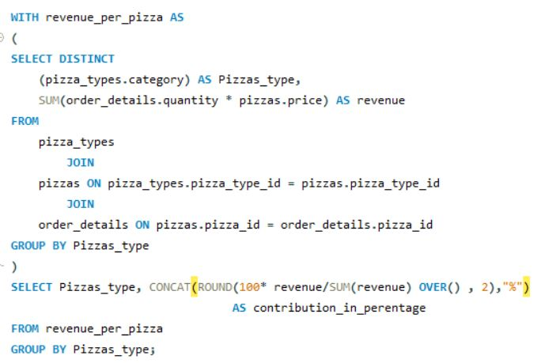
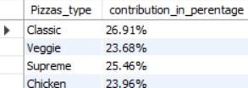
11) Calculate the percentage contribution of each pizza type to total
revenue.

Slide 16
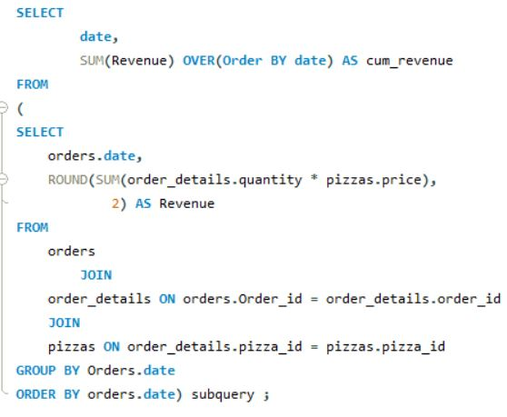
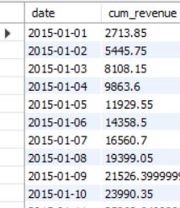
12) Analyse the cumulative revenue generated over time.

Slide 17
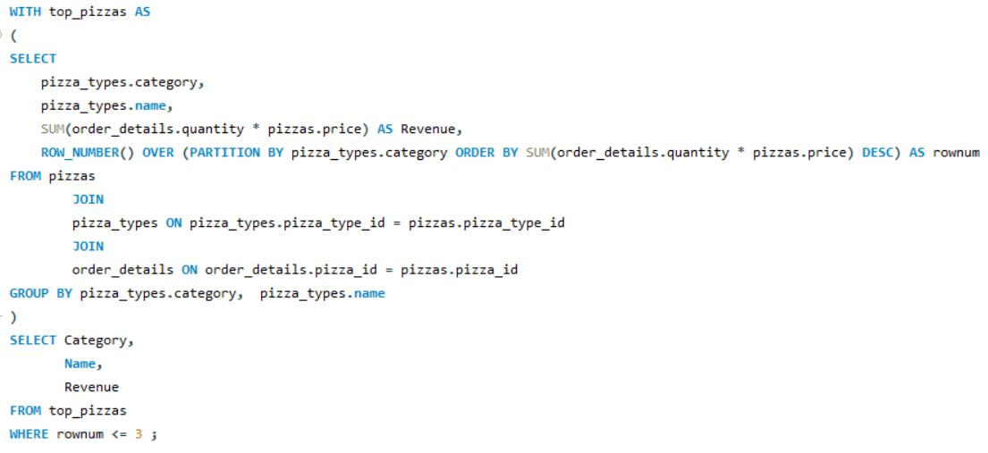
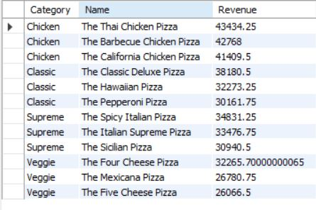
13) Determine the top 3 most ordered pizza types based on
revenue for each pizza category.

Slide 18
RESULTS
After study, it is determined that the Greek Pizza, at $35.95, is the most expensive pizza available.
The most popular pizza order is for a large size.
Thai chicken pizza, Hawaiian pizza, pepperoni pizza, barbecue chicken pizza, and classic deluxe pizza. These five pizzas are the best.
An average of 138 pizza orders are placed per day.
The pizzas are priced at $43434.25 for Thai chicken, $42768 for barbecue chicken, and $41409.5 for California chicken. These are the top three pizzas in terms of sales.

Slide 19
OVERALL CONCLUSION
This study provides valuable insights into customer preferences and pricing strategies that can guide business decisions in menu design and marketing.
By understanding which pizzas are most popular and which sizes are favoured, the business can tailor its menu to meet customer demands more effectively. This information helps optimize the product mix, ensuring that the most popular and profitable items are highlighted leading to increased sales and customer satisfaction.

